Slide 2
Using the Data Science VM for Developing and Deploying Data Science Solutions
Notes:
Paul Shealy - Senior Software Engineer
Barnam Bora – Program Manager II
Udayan Kumar – Software Engineer II

Slide 3
Session Goals
Understand the Azure Data Science VM
And its role in the data science process
Hands-on experience with the DSVM by exploring several key scenarios
Dev → Prod (Windows)
SQL Server with R Services (Windows)
Spark local with PySpark (Ubuntu)
Take home: how the DSVM enables your data science work
Broad, not deep
Notes:
Scenario walkthroughs:
1) SQL Server R services : Dev→ Train → Test → Deploy → Score
2) Use local spark instance on the DSVM for Dev & Test
3) Training & deploying Deep Learning Models using deep learning toolkit for DSVM on GPU based azure VMs
4) Briefly querying & wrangling across platforms

Slide 4
Before we begin
You need
One Data Science Virtual Machine (Windows 2012)
We recommend at least 4 cores (e.g., DS3_v2)
One Data Science Virtual Machine for Linux (Ubuntu) w/ password auth
We recommend at least 2 cores (e.g., DS2_v2)
You can use
An internal Azure subscription
FTE MSDN Azure credits (my.visualstudio.com)
A free trial (azure.microsoft.com/free)
Notes:
Four DSVM flavors

Slide 5
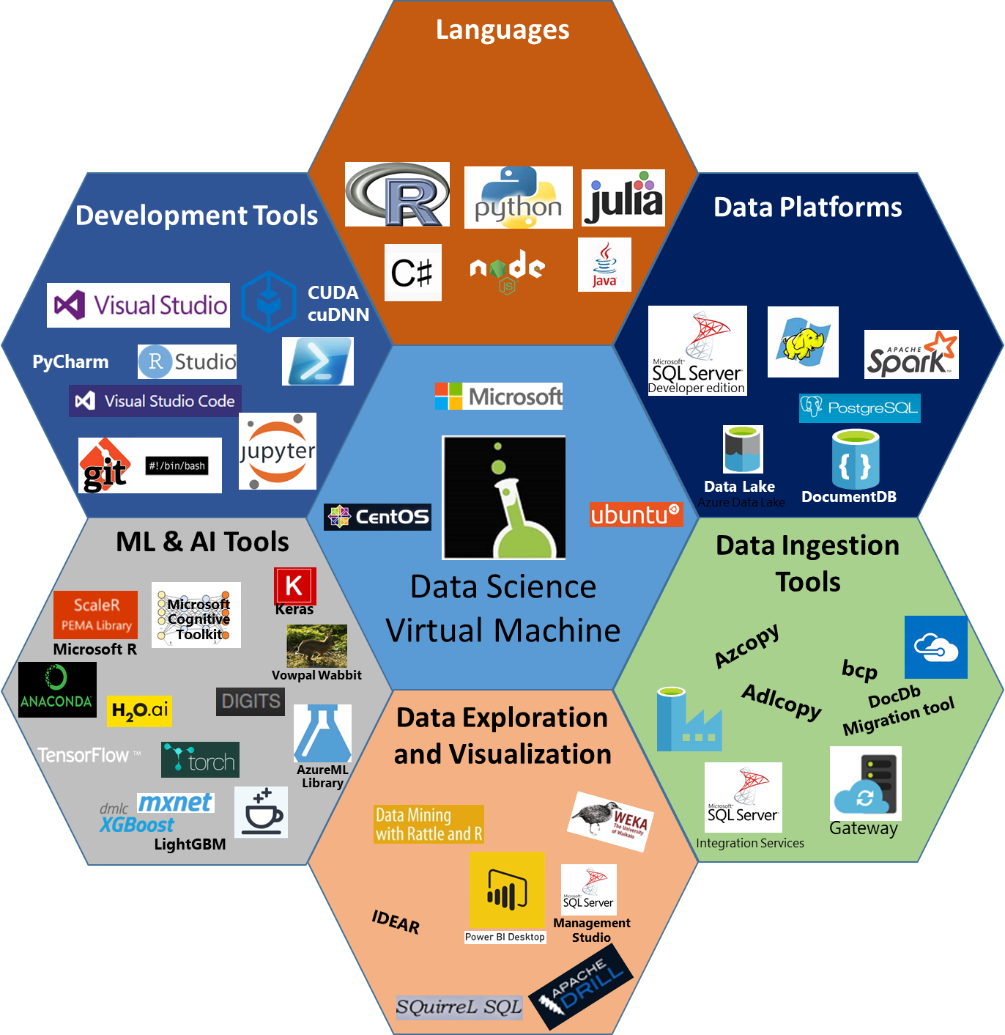
What is the Data Science VM?
Comprehensive cloud based Data Science Environment to empower Data Scientists
https://aka.ms/dsvm/overview
Notes:
What is the DSVM?
It is a set of VMs available in Azure with a large set of Data Science tools preconfigured, ready to go out of the box.
We have 4 flavors:
Windows 2012 / 2016
Linux with CentOs or Ubuntu (primary dev efforts will be here)
Tools:
- R/Python/Julia/etc. + PowerBI + Apache Drill
- Data platforms (SQL Server 2016 on Windows, Azure Data Lake and HDInsight tools in VS 2015, Spark and Hadoop on Linux), plus tools like Squirrel SQL, ODBC/JDBC drivers
- Data movement tools: these, plus Azure CLI
- ML + AI: deep learning + GPU support on new images. LightGBM in Linux. MicrosoftML. MRS.
Xgboost, tensorflow, CNTK, MXNet (GPU versions), cuda, cuDNN, Nvidia driver installed –Windows GPU version
GPU versions linux – toch, café, cafe2, keras, etc
VS + vs code
We enable many workflows. Also use it to experiment with new tools.
Discuss: Windows 2012 versus 2016, Ubuntu vs CentOS. Deep learning + GPU support on new images.
https://docs.microsoft.com/en-us/azure/machine-learning/machine-learning-data-science-virtual-machine-overview

Slide 6
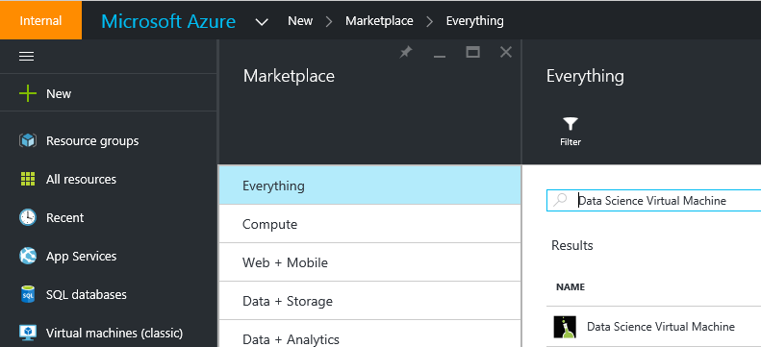
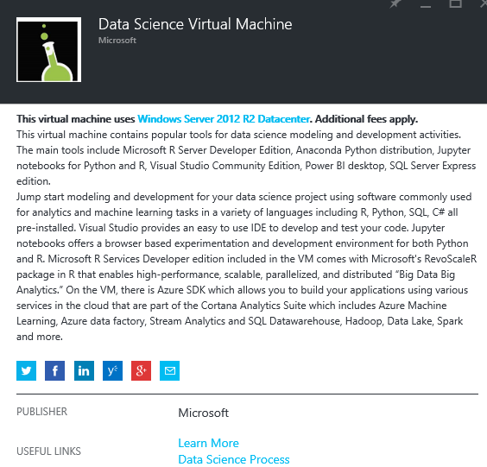
Microsoft Data Science Virtual Machine
https://ms.portal.azure.com/#create/microsoft-ads.standard-data-science-vmstandard-data-science-vm
Learn More at https://azure.microsoft.com/en-us/documentation/articles/machine-learning-data-science-provision-vm/

Slide 7
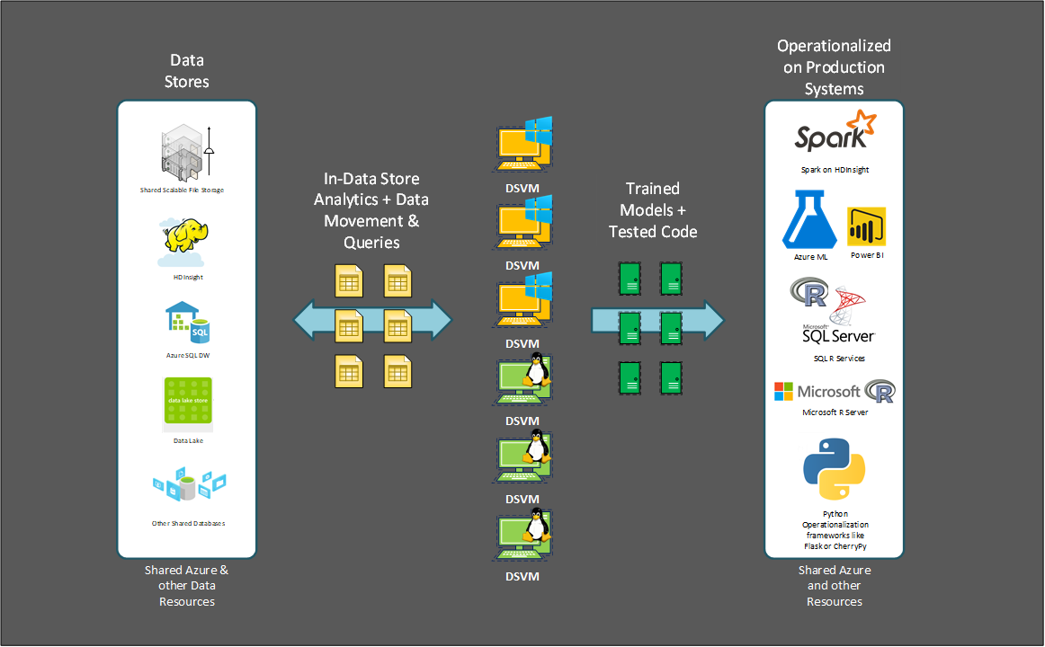
Development flow with the DSVM

Slide 8
Key Scenarios
Analytics desktop in the cloud
Data science training and education
On-demand elastic capacity
Experimentation and evaluation
Deep learning
Notes:
Desktop: consistent setup, Azure scale, little setup required
Training: Consistent environment, easy to set up and tear down, shared/dedicated infrastructure
Elastic capacity: Pay for what you use. E.g., hackathons, competitions
Experimentation and evaluation: Spend time evaluating instead of setup
Deep learning: CPU/GPU, scale instance based on need

Slide 9
Dev → Prod
Notes:
Udayan Kumar

Slide 10
Hands-on
Notes:
Udayan Kumar

Slide 11
Steps to start the Jupyter notebook
On Win DSVM, click “Jupyter Set Password & Start”
Set the password and click any key to start the jupyter server
Next open https://localhost:9999/ on a browser – IE or Firefox
Confirm the security exception!
Open notebook - Introduction to Azure ML R notebooks.ipynb

Slide 12
Add zip to the path
Open Firefox and go to https://aka.ms/dsvm/zip
Save the file Cntl-S with ps1 extension
Run the ps1 with PowerShell

Slide 13
Walk through the tutorial

Slide 14
Rest API

Slide 15
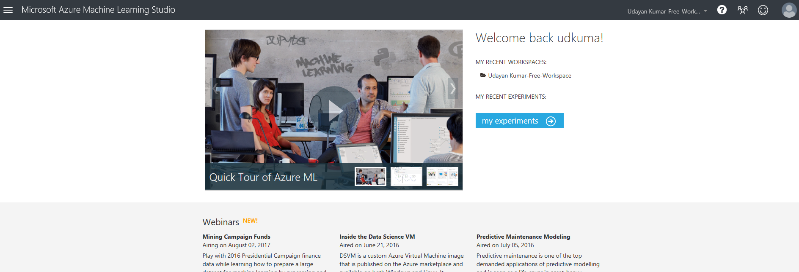
Azure ML Studio
https://studio.azureml.net

Slide 16
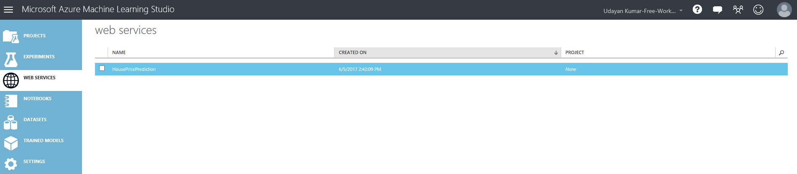
Access rest API Details

Slide 17
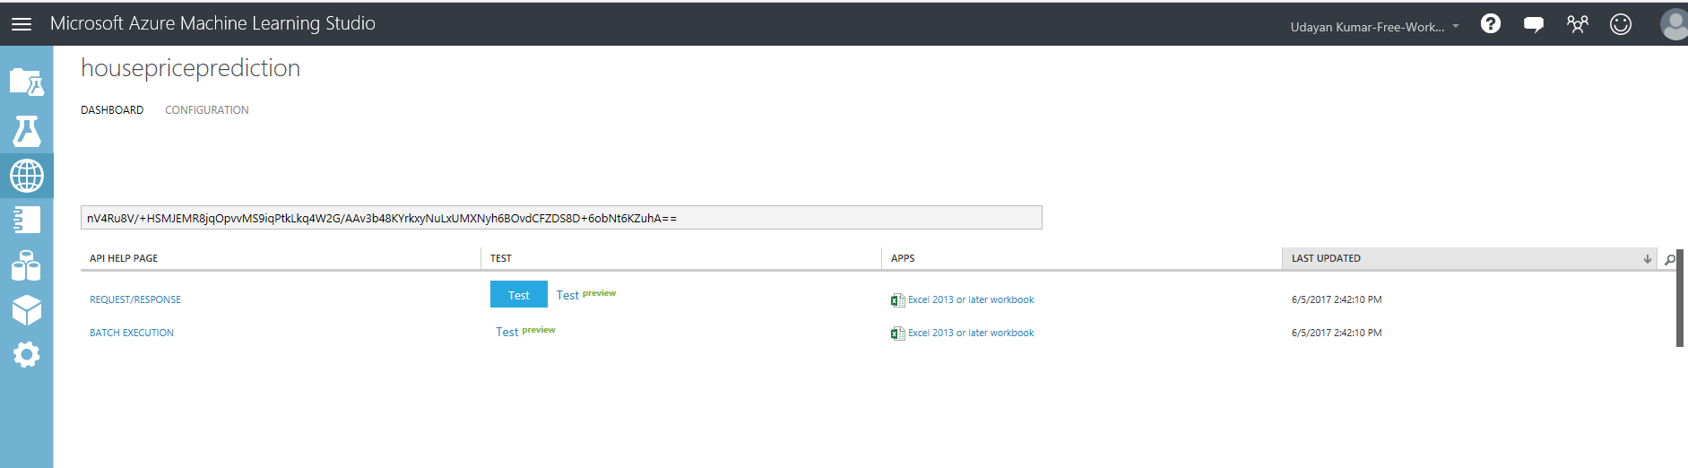
Location of API key
API Key

Slide 18
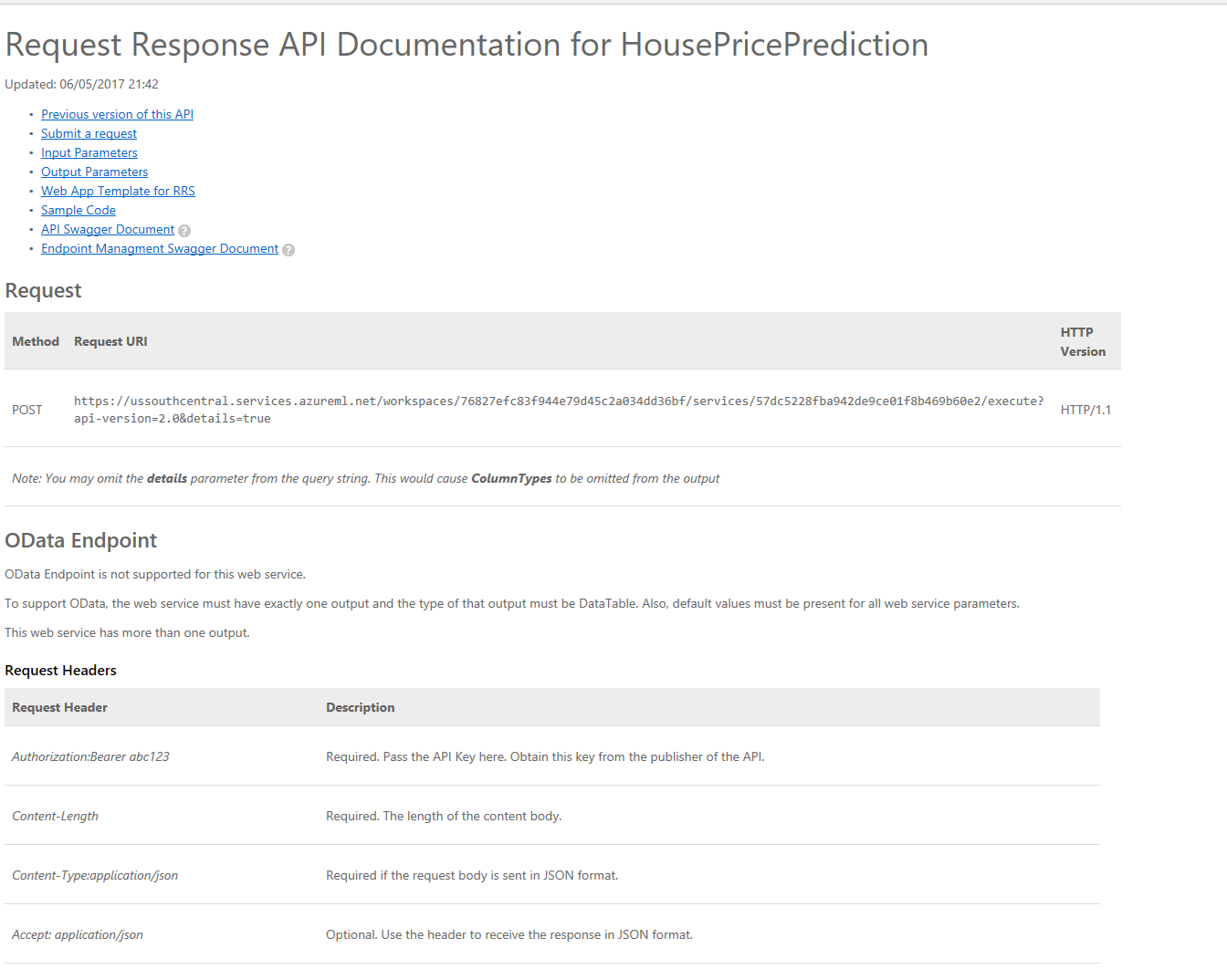
Rest API document

Slide 19
SQL Server R Services
Notes:
Barnam Bora

Slide 20
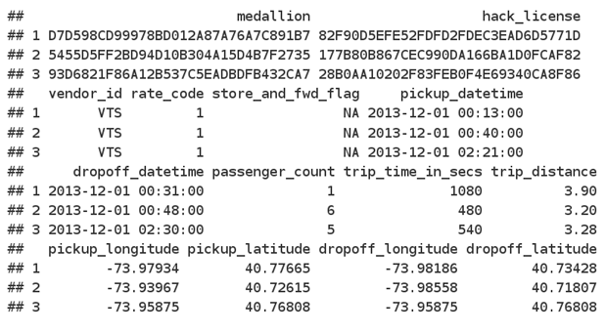
Hands-on: SQL Server R Services
The data used for this exercise is the public NYC Taxi Trip and Fare dataset (December 2013, ~4Gb, ~13 million rows), available from http://www.andresmh.com/nyctaxitrips
Dev → Train → Test → Deploy → Score
https://aka.ms/dsvm/springmlads2017/sqlr

Slide 21
Hands-on

Slide 22
Spark
Notes:
Paul Shealy

Slide 23
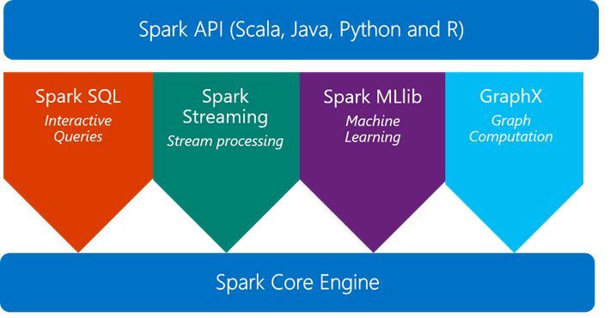
Hands-on: Spark

Slide 24


Hands-on: Spark
Spark Cluster in HDInsight
Local Spark on the DSVM
Head and Worker Roles handled and optimized on the box by Spark Local processes

Slide 25
Hands-on

Slide 26
Hands-on
Open JupyterHub: in a browser, navigate to https://your-dsvm-ip:8000 and log in
Click New (in the top-right corner) and choose Terminal
Run this command in the terminal:
wget –O – aka.ms/dsvm/mlads | bash

Slide 27
Useful links
DSVM Forum for questions, feedback and feature requests - http://aka.ms/dsvm/forum
Windows Product Page – http://aka.ms/dsvm Windows documentation – http://aka.ms/dsvmdoc
Ubuntu: product page – http://aka.ms/dsvm/ubuntu
Deep learning toolkit for DSVM - http://aka.ms/dsvm/deeplearning
Test drive - https://aka.ms/dsvm/testdrive
DSVM Introductory DIY workshop – http://aka.ms/dsvm/workshop
2 Page Handout – http://aka.ms/dsvm/handout
Learn Analytics @ Microsoft – http://learnanalytics.microsoft.com

Slide 29
Appendix

Slide 30
What’s included? A partial list…
Windows
Microsoft R Open with popular packages pre-installed
Microsoft R Server Developer Edition
Anaconda Python 2.7, 3.5
JuliaPro with popular packages pre-installed
Jupyter Notebook Server (R, Python, Julia)
SQL Server 2016 Developer Edition
IDEs and Editors
Visual Studio Community Edition 2015 (IDE)
Azure HDInsight (Hadoop), Data Lake, SQL Server Data tools
Node.js, Python, and R tools for Visual Studio
RStudio Desktop
Power BI desktop
Machine Learning Tools
Integration with Azure Machine Learning
Microsoft Cognitive toolkit (CNTK)
Xgboost
Vowpal Wabbit (fast online learner)
Rattle (visual quick-start data and analytics tool)
Mxnet (deep learning/AI)
Tensorflow
SDKs to access Azure and Cortana Intelligence Suite of services
Tools for data movement and management of Azure and Big Data resources: Azure Storage Explorer, CLI, PowerShell, etc.
Git, Visual Studio Team Services plugin
Weka
Apache Drill
Linux
Microsoft R Open with popular packages pre-installed
Microsoft R Server Developer Edition
Anaconda Python 2.7, 3.5 with popular packages pre-installed
JuliaPro with popular packages pre-installed
JupyterHub: Multi-user Jupyter notebooks (R, Python, Julia, PySpark)
SQuirreL SQL (database tool), SQL Server drivers, bcp, sqlcmd
IDEs and editors
Emacs (with ESS, auctex) gedit
IntelliJ IDEA
PyCharm
Atom
Visual Studio Code
Machine Learning Tools
GPU tools: NVIDIA driver, CUDA, cuDNN
Deep learning: CNTK, TensorFlow, mxnet, Caffe, Theano, etc. Xgboost
Vowpal Wabbit (fast online learner)
Rattle (visual quick-start data and analytics tool)
Integrations with Azure Machine Learning
SDKs to access Azure and Cortana Intelligence Suite of services
Azure Storage Explorer, Azure CLI
Git
Weka
Apache Drill
Apache Spark - local instance
Notes:
We enable many workflows. Also use it to experiment with new tools.
https://docs.microsoft.com/en-us/azure/machine-learning/machine-learning-data-science-virtual-machine-overview

